Slide 1
Topic 4 Gaussian filters (Reference 2, Ch. 3)

Slide 2
Autonomous mobile robots
autonomy
Vehicle
Actuators
Vehicle model
Sensors
Control
Vehicle autonomy
Path & motion planning
Localization
Perception
Independent from user
Localization & mapping
Independent from environment

Slide 3
Introduction
Gaussian filters constitute the earliest implementations of the Bayes filter for continuous spaces.
Despite a number of shortcomings they are the most popular family of techniques.
Gaussian techniques all share the idea that beliefs are represented by multivariate normal distributions:

Slide 4
Introduction
The commitment to represent the posterior by a Gaussian has important ramifications:
Gaussians are unimodal so they possess a single maximum. This is characteristic of many problems in robotics.
Gaussian posteriors are a poor match for many global estimation problems, in which many distinct hypotheses exist.
This type of representation is known as moments parameterization.
The alternative parameterization is known as the canonical (or natural) parameterization.

Slide 5
The Kalman Filter
The best studied technique for implementing Bayes filter is the Kalman filter (KF).
The KF implements belief computation for continuous states. It is not applicable to discrete or hybrid state spaces.
The KF represents beliefs by the moments parameterization. Posteriors are Gaussian if the following 3 properties hold (in addition to the Markov assumption).

Slide 6
Condition 1
The state transition probability p(x_{t}|u_{t},x_{t-1}) must be a linear function in it arguments with Gaussian noise. KF assume linear system dynamics.
n x n
n x m
Process noise with
mean=0 & covariance=R_{t}

Slide 7
Condition 1
Now we can propagate the state forward by plugging the value of the expected mean and variance into the posterior probability:

Slide 8
Condition 2
The measurement probability p(z_{t}|x_{t}) must also be linear in its arguments, with added Gaussian noise.
k x n
Measurement noise with
mean=0 & covariance=Q_{t}

Slide 9
Condition 2
Now we calculate the measurement using these values:

Slide 10
Condition 3
The final condition is that the initial belief bel(x₀) is normally distributed with mean μ₀ and covariance Σ₀

Slide 11
The Kalman Filter Algorithm
Kalman gain
Innovation

Slide 12
The Kalman filter
The complexity of the matrix inversion of the KF is approximately O(d^{2.4}).
Each iteration of the Kalman filter is lower bounded by O(k^{2.4}), where k is the dimension of the measurement vector z_{t}.
For sparse updates (not many measurements) the Kalman filter is lower bounded by O(n²), where n is the dimension of the state space.

Slide 14
The Extended Kalman Filter (EKF)
Unfortunately, state transition and measurements are rarely linear in practice.
For example, a robot that moves with constant translational and rotational velocity typically moves on a circular trajectory, which cannot be described by linear state transitions.
This observation makes the application of plain Kalman filters inapplicable to all but the most trivial robotics problems.

Slide 15
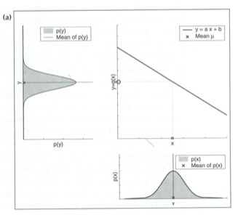
Nonlinear transformation

Slide 16
The EKF
The EKF relaxes the linearity assumption, such that the state transition and measurement probabilities are governed by nonlinear functions:
Unfortunately with this assumption the belief is no longer a Gaussian and the Bayes filter does not possess a closed-form solution.

Slide 17
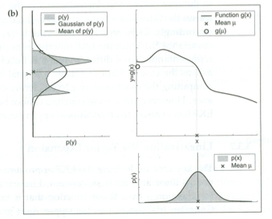
Nonlinear transformation

Slide 18
Linearization via Taylor Expansion
The key idea underlying the EKF is linearization.
Linearization works by approximating a non-linear function g by a linear function that is tangent to g at a local position.
Projecting the Gaussian through this linear approximation results in a Gaussian density.
The key advantage of linearization lies in its efficiency.
Linearization also applies to the measurement function, where the EKF approximates h by a linear function tangent to h.

Slide 19
Taylor series approximation
EKF uses a first order Taylor series expansion approximation to linearize its functions. The slope of a function g is given by:

Slide 20
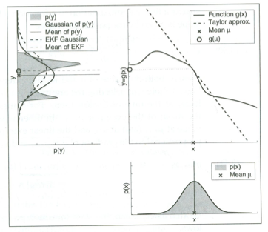
Linearization of EKF

Slide 21
State transition probability
The state transition probability is written as:
Jacobian
n x n
The Jacobian depends on u_{t} and μ_{t-1}. It is therefore different for different points in time.

Slide 22
Measurement
EKF implements the same linearization for the measurement function h. Here the Taylor expansion is developed around
Written as a Gaussian:

Slide 23
EKF

Slide 24
Practical considerations
The EKF is the most popular tool for state estimation in robotics.
Each update requires time O(k^{2.4}+n²), where k is the size of the measurement vector and n is the size of the state vector.
The EKF owes its computational efficiency to the fact that it represents the belief by a multivariate Gaussian distribution.

Slide 25
Practical considerations
An important limitation to the EKF is the fact that it approximates state transitions and measurements using linear Taylor expansions.
The goodness of this linear approximation depends on two things:
the degree of uncertainty
the degree of local non-linearity of the functions that are being approximated.

Slide 26
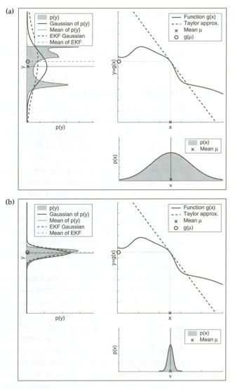
Degree of uncertainty

Slide 27
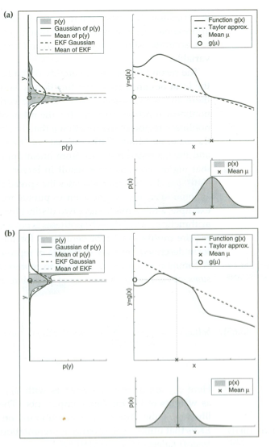
Local nonlinearity

